Slide 1
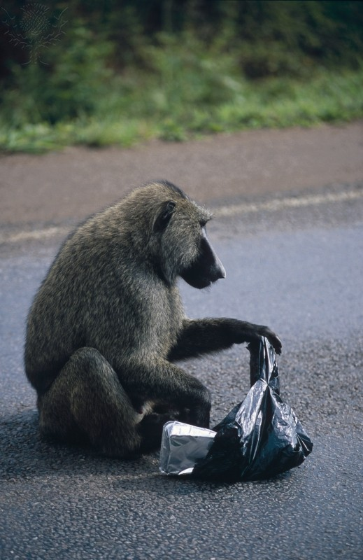
Plagiarism Workshop

Slide 2
What’s my name?
Mrs. McVeigh
Ms. Farrell
Ms. Podgorska

Slide 3
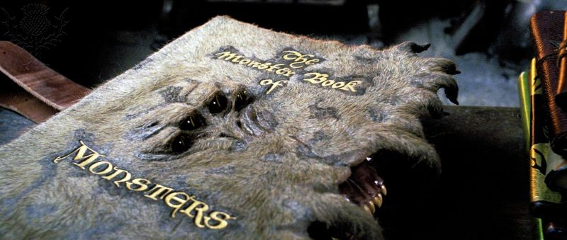
Who are we?

Slide 4
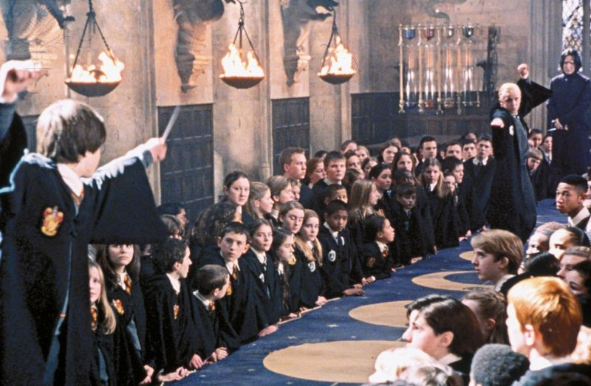
We are…
Your Allies in learning

Slide 5
Why are we doing this workshop?
Because we are mean
Because we had to do it, so you have to do it
So that you are successful

Slide 6
What is “academic integrity”?
INTEGRITY =
honesty, being honest
having strong moral principles

Slide 7
What is plagiarism?
York U: Plagiarism is representing someone else's ideas, writing or other intellectual property as your own, and is [a] form of academic dishonesty.

Slide 8
Works Cited
Eastern Uganda. Photography. Encyclopædia Britannica Image Quest. Web. 25 Sep 2012. http://quest.eb.com/images/137_3319889
HARRY POTTER AND THE PRISONER OF AZKABAN (2004). Photography. Encyclopædia Britannica Image Quest. Web. 17 Sep 2012. http://quest.eb.com/images/144_1536319
HARRY POTTER AND THE CHAMBER OF SECRETS (2002). Photography. Encyclopædia Britannica Image Quest. Web. 17 Sep 2012. http://quest.eb.com/images/144_1539475
"The Academic Integrity Tutorial." York University. N.p., 26 Aug. 2012. Web. 4 Oct. 2012. http://www.yorku.ca/tutorial/academic_integrity/plagdef.html

Slide 9
Tutorial
You Quote It, You Note It
You Quote It, You Note It. Vaughan Memorial Library, Acadia University, 2008. Web. 4 Oct. 2012. http://library.acadiau.ca/sites/default/files/library/tutorials/plagiarism/

Slide 10
In your work
Look for √ | Look for X
Use of a direct quotation | Copying
Use of a paraphrase that is clearly acknowledged | Paraphrasing without acknowledgement
Use of citations within the text (aka “embedded citations”) | Using an idea or information without acknowledgement
 | Making up references to non-existent articles

Slide 11
Tool to create citations/references
Nicknamed, “Citation Maker”

